Slide 1
DS4023（2025 Fall） Machine Learning Department of Computer Science Beijing Normal-Hong Kong Baptist University

Slide 2
Course Information
Teaching:
Lecture: Dr. Jianxiong Guo
Office: T3-501-R8, Email: jianxiongguo@uic.edu.cn
Teaching Assistant: Ms. Fangyi Mou
Office: V25-102-25, Email: moufangyi@uic.edu.cn
Lecture Scheduling:
Mon 10:00-11:50 (T6-202), Thu 9:00-9:50 (T7-503)

Slide 3
Jianxiong Guo (郭剑雄)
北师香港浸会大学
计算机科学系，助理教授
广东省人工智能与多模态数据处理重点实验室
北京师范大学(珠海校区)
自然科学高等研究院，副教授，博导
大数据云边只能协同教育部工程研究中心，副主任
交叉智能超算中心
中国计算机学会分布式、物联网、普适计算专委执行委员
IEEE/ACM Member
研究方向：
物联网、边缘智能、分布式机器学习、优化理论等
谷歌学术：https://scholar.google.com/citations?hl=zh-CN&user=lljLdDcAAAAJ

Slide 4
Assessment Method
Assignment (Writing and Programming): 30%
Final Project: 30%
Final Exam (One cheat page): 40%

Slide 5
Schedule
Week | Teaching content |  | Assignment
1 | Introduction
2 | Statistical learning | Parameter estimation, Bayes | A1
3 |  | MAP, MPD
4 |  | Linear regression | A2
5 | Supervised learning | Logistic regression, SVM
6 |  | Boosting, random forest | A3
7 |  | Neural networks
8 | Reading week
9 |  | Deep learning | A4
10 | Unsupervised learning | K-means, HC, GMM, EM
11 |  | Self organizing map, KDE,
12 | Dimensionality reduction | Subspace method, non-linear manifold embedding | A5
13 | Final PRE
14 | Final PRE

Slide 6
Chapter 1: Introduction

Slide 7
Course Objective
The course gives an introduction to machine learning and its applications.
The course aims to provide the students the basic ideas and intuition about machine learning algorithms as well as its implementation and application.
Besides, there will be Python Workshops on various basic Machine Learning and AI Technologies/applications, such as Pytorch, Various Supervised, Unsupervised, and Reinforcement Learning technologies, Artificial Neural Networks, and Deep Networks.
Notes:
神经网络：1943年提出，早期就是MP网络，后来被用作一种ML模型。
深度学习：模型比较复杂，从输入到输出链路比较长，解决每个模块对最终决策的贡献是多少。
深度学习主要的模型是神经网络，可近似等同，单内涵不一样。
交集（本课程主要内容）：以神经网络为主要模型的深度学习。

Slide 8
Overview of ML Family
Notes:
概率图模型：以概率的形式建模各式各样的学习问题。
EM：含有隐变量。
概率图模型和ML结合->密度估计

Slide 9
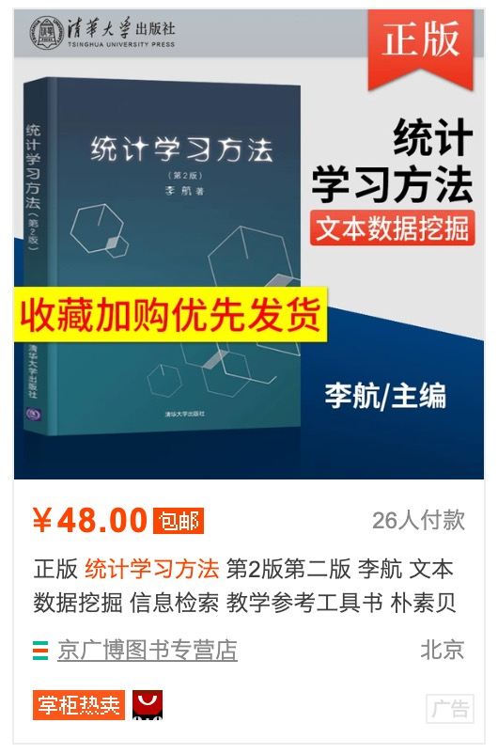

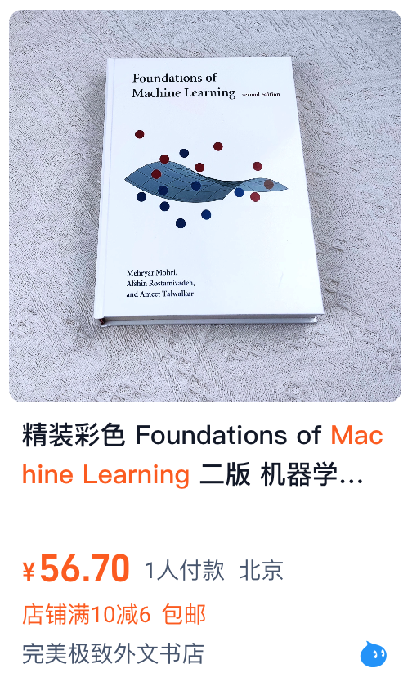
Reference textbook (Chinese & English)

Slide 10
Recommended teaching materials
阿斯顿·张等,动手学深度学习, ISBN: 9787115505835.
Dive into Deep Learning, https://d2l.ai/
Bishop, C.M. (2006). Pattern recognition and Machine Learning. Springer. ISBN 9780387310732.
Goodfellow, Ian (2016). Deep Learning. MIT Press.
李航等, 统计学习方法(第二版), ISBN: 9787302517276.
周志华等, 机器学习, ISBN: 9787302423287.
龙曲良等，Tensorflow深度学习(深入理解人工智能算法设计).
Convex Optimization Textbooks：
Wright, S., & Nocedal, J. (1999). Numerical optimization. Springer, 35(67-68), 7.
Boyd, S., & Vandenberghe, L. (2004). Convex optimization. Cambridge University Press. (凸优化教材圣经）

Slide 11
Recommended Courses
斯坦福大学CS224n: Deep Learning for Natural Language Processing
https://web.stanford.edu/class/archive/cs/cs224n/cs224n.1194/
Chris Manning 主要讲解自然语言处理领域的各种深度学习模型
斯坦福大学CS231n: Convolutional Neural Networks for Visual Recognition
http://cs231n.stanford.edu/
Fei-Fei Li Andrej Karpathy 主要讲解CNN、RNN在图像领域的应用
加州大学伯克利分校 CS 294: Deep Reinforcement Learning
http://rail.eecs.berkeley.edu/deeprlcourse/

Slide 12
Recommended Materials
林轩田“机器学习基石” “机器学习技法”
https://www.csie.ntu.edu.tw/~htlin/mooc/
李宏毅 “1天搞懂深度学习”
http://speech.ee.ntu.edu.tw/~tlkagk/slide/Tutorial_HYLee_Deep.pptx
李宏毅 “机器学习2020”
https://www.bilibili.com/video/av94519857/
Notes:
李宏毅《Generative Adversarial Network (GAN)》
http://speech.ee.ntu.edu.tw/~tlkagk/slide/Tutorial_HYLee_GAN.pptx

Slide 13
Prepare Mathematical Knowledge
Linear Algebra: Matrix calculation
Calculus: It doesn't need to be very deep, just the common differential integral
Mathematical optimization: Gradient descent
Probability theory: Density function, expected variance, etc.
Information theory: Cross entropy

Slide 14
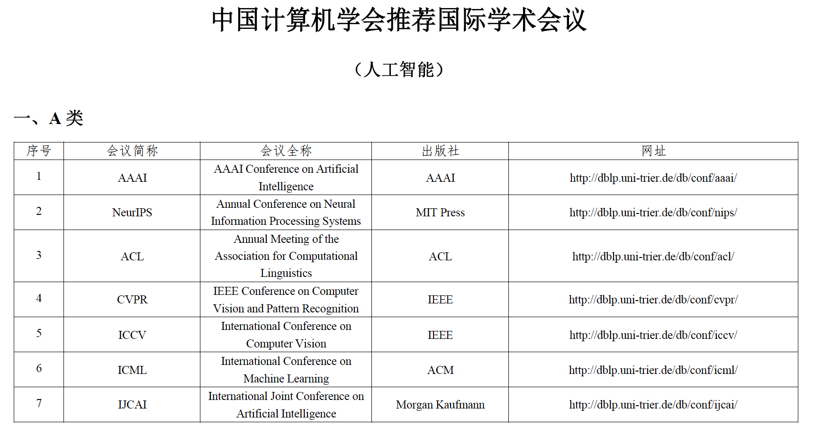
Top Conferences
AI: NeurIPS/ICML/ICLR/AAAI/IJCAI
CV: CVPR/ICCV/ECCV
NLP: ACL/EMNLP/NAACL

Slide 15
Machine Learning Framework
Scikit-learn: https://scikit-learn.org/stable/
The Python library, Scikit-Learn, is built on top of the matplotlib, NumPy, and SciPy libraries.
Simple, easy to use, and effective.
In rapid development, and constantly being improved.
Wide range of algorithms, including clustering, factor analysis, principal component analysis, and more.
Can extract data from images and text.
This library is especially suited for supervised learning, and not very suited to unsupervised learning applications like Deep Learning.

Slide 16



Deep Learning Framework
Simple and fast prototype design
Automatic gradient calculation
Switching CPU and GPU
Distributed

Slide 17
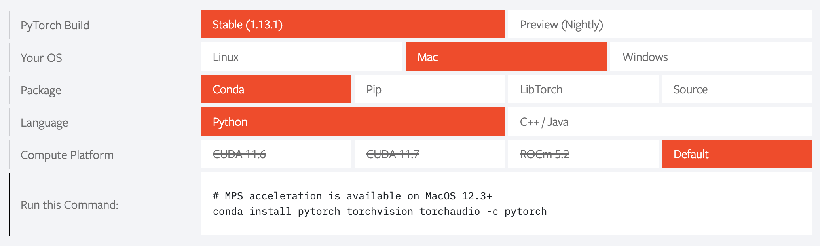
PyTorch Installation and Usage
PyTorch website：https://pytorch.org/
PyTorch document：https://pytorch.org/docs/stable/index.html
Install: Python, Jypter notebook, Pytorch, etc.
Install tutorial：https://www.bilibili.com/video/BV1Jg411c72R/?spm_id_from=333.337.search-card.all.click&vd_source=1c8c97959927ae70af2fd929f2a41663

Slide 18
1.1 Artificial Intelligence

Slide 19
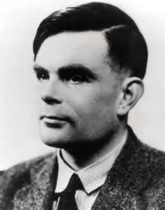
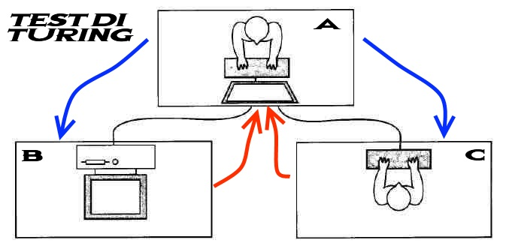
Turing Test
"A person has a series of questions and answers with each other in a special way without touching each other. If for a long time, he can't judge whether the other party is a person or a computer according to these questions, then he can think that this computer is intelligent. "
---Alan Turing [1950]
《Computing Machinery and Intelligence》
Alan Turing
Notes:
1950年图灵测试：“一个人在不接触对方的情况下，通过一种特殊的方式，和对方进行一系列的问答。如果在相当长时间内，他无法根据这些问题判断对方是人还是计算机，那么就可以认为这个计算机是智能的”。

Slide 20
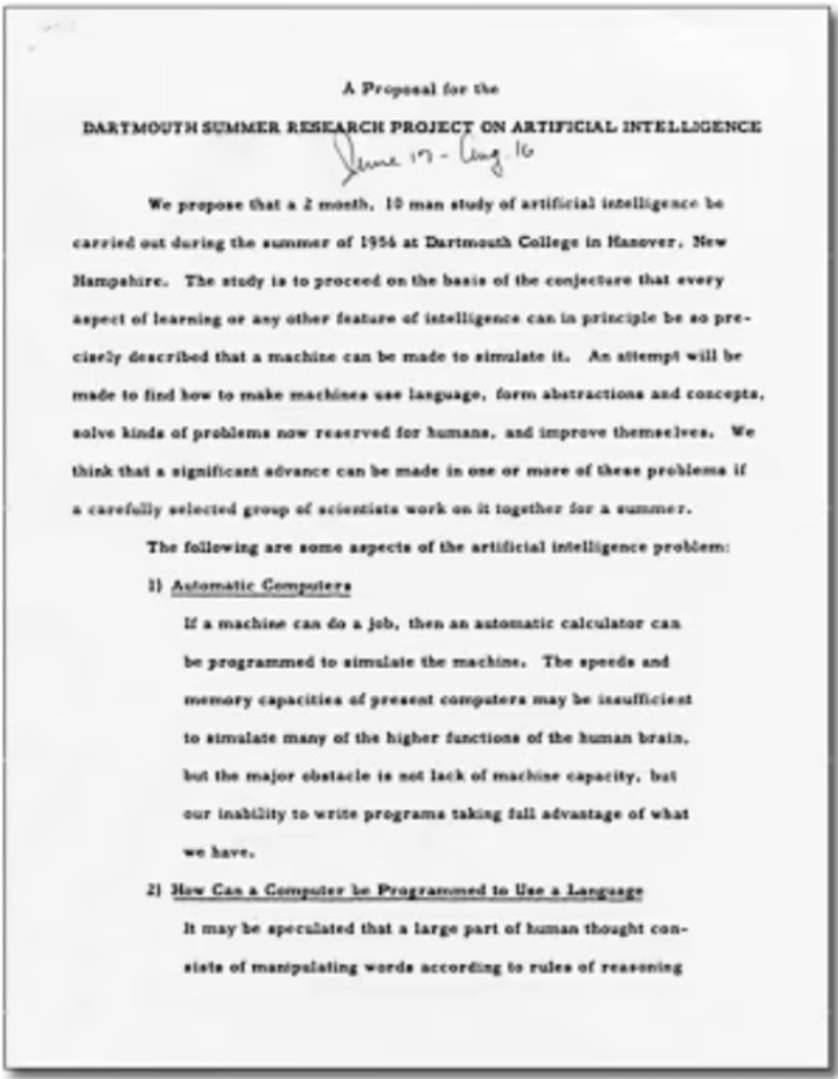
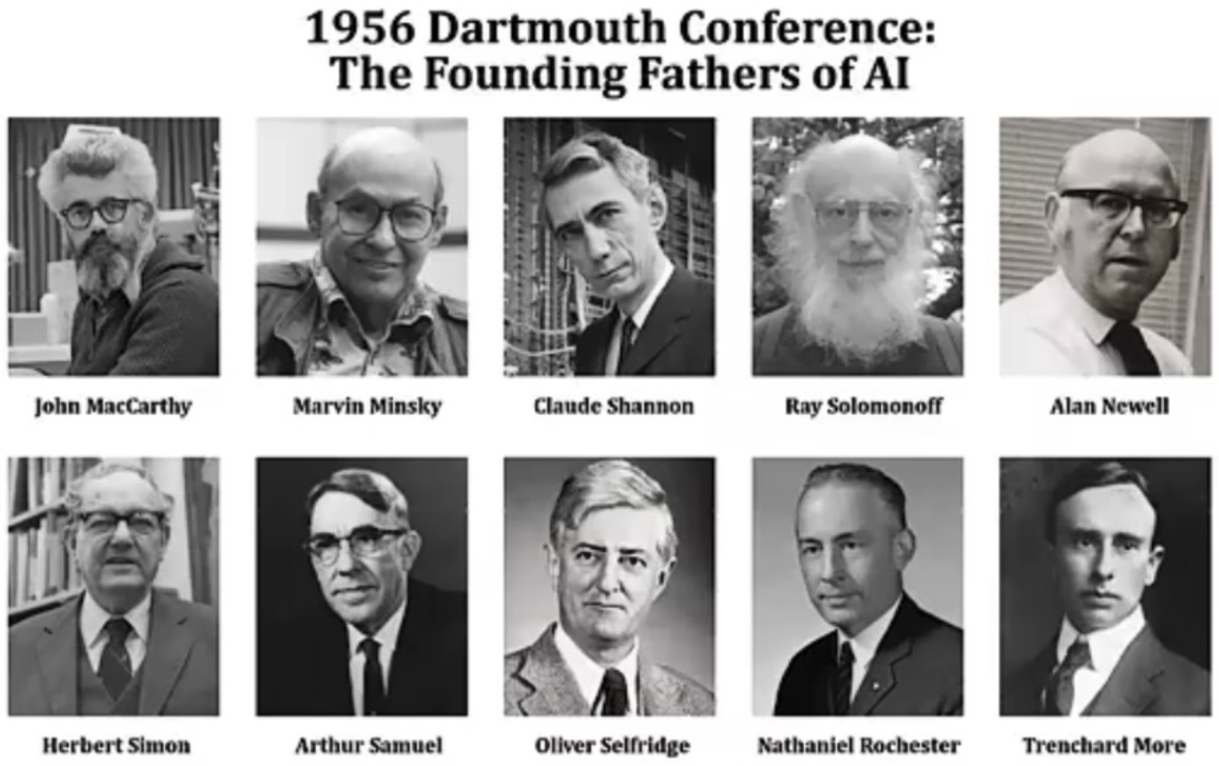
Artificial Intelligence (AI)
The birth of AI: The birth of AI has a clear landmark event: the 1956 Dartmouth conference. At this meeting, "artificial intelligence" was proposed as the name of this research field.

Slide 21
Artificial Intelligence
Artificial intelligence (AI) is to make machines have human intelligence.
Computer Control + Intelligent Behavior
Artificial intelligence is to make the behavior of machines look like the intelligent behavior of people.
John McCarthy（1927-2011）
Notes:
智能（intelligence）是现代生活中很常见的一个词，比如智能手机、智能家居、智能驾驶等。
AI不等于类脑智能，没有规定技术路线。
分成很多流派：1.连接主义，神经元（缺乏解释性）；2.符号主义，人的知识是用符号定义的；3.行为主义：智能是由与环境交互实现的。

Slide 22
Research Areas in AI
Turing test is an essential factor to promote AI from philosophical discussion to scientific research, and has guided many research directions of AI.
To make computer pass Turing test, computer must understand language, learn, remember, reason, and make decisions.
Let machines have human intelligence
Machine Perception (CV, Speech info. Processing, Pattern Recog.)
Learning (ML, Reinforcement Learning (RL))
Language (Natural Language Processing (NLP))
Memory (Knowledge Representation）
Decision-making (Planning, Data Mining)

Slide 23
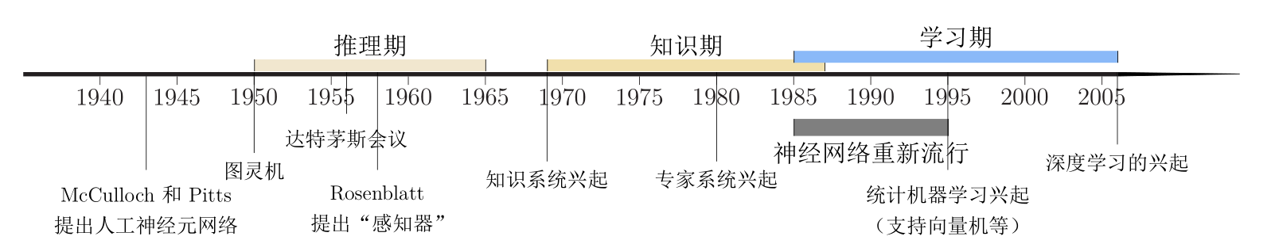
Development History
Notes:
WordNet，知识期：专家知识
规模越来越大，维护困难，知识冲突

Slide 24
1.2 How to develop AI system

Slide 25
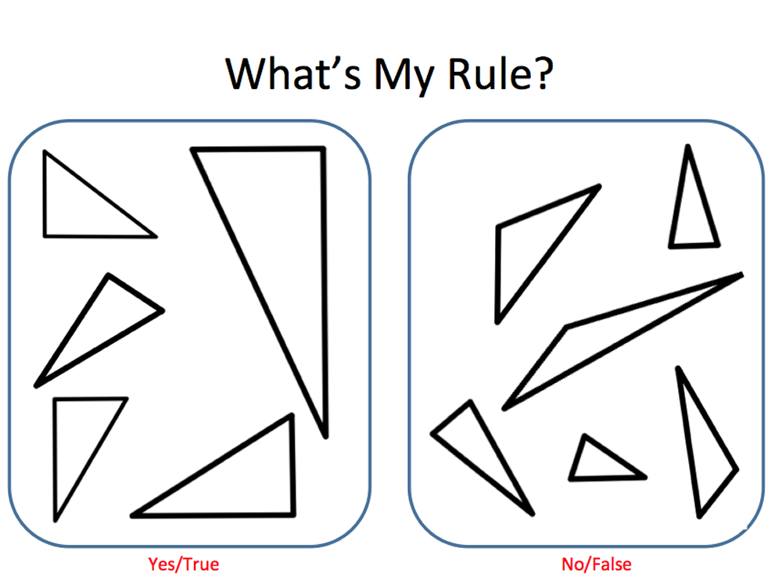
How to develop an AI system?
Expert knowledge (manual rules)
Notes:
写一个程序把这两堆三角形分开，怎么实现？（简单规则，也能达到某种智能）
专家系统：医生看病

Slide 26

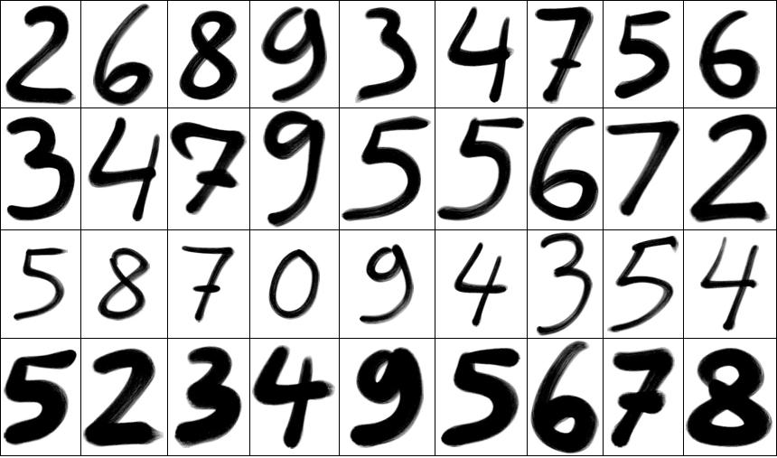
What’s the Rule?
Machine Learning!
Notes:
语音信号，手写体，人能看懂，但是难以总结规则。

Slide 27
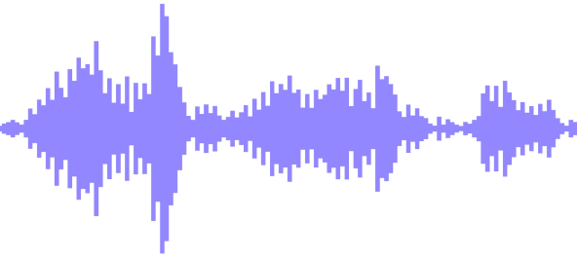

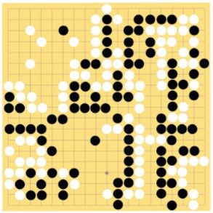
Machine Learning ≈ Construct a mapping function (rule)
Speech recognition
Image recognition
围棋
Machine Translation
“你好”
“9”
“6-5”
(落子位置)
“你好！”
“Hello!”

Slide 28
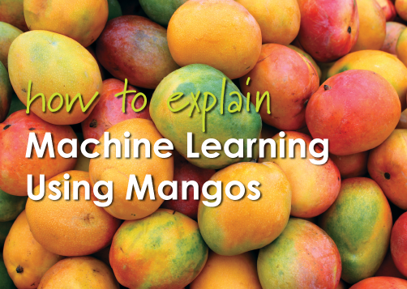
Mango ML
How to judge whether mango is sweet?
https://www.quora.com/How-do-you-explain-Machine-Learning-and-Data-Mining-to-non-Computer-Science-people
Notes:
芒果机器学习：如果判断芒果是否甜蜜？
构建函数，分类问题

Slide 29
Mango ML
Prepare data for training
Randomly selected mango samples from the market (training data), list all the characteristics of each mango:
Such as color, size, shape, origin, brand, and price
Mango quality (output variable):
Sweet, juicy, and mature
Learning
Design a learning algorithm to learn the correlation model between mango features and output variables.

Slide 30
Mango ML
Testing
The next time you buy mango from the market, you can use the model calculated above to predict the quality of mango according to its characteristics (test data). (Accuracy)

Slide 31
How to develop an AI system?
Knowledge
Know how to do
Not know how to do
Expert system
ML
…
CV
NLP
Speech
Not easy to do
Easy to do
RL
Weiqi
Rule
Notes:
车牌识别？

Slide 32
1.3 Representation Learning

Slide 33
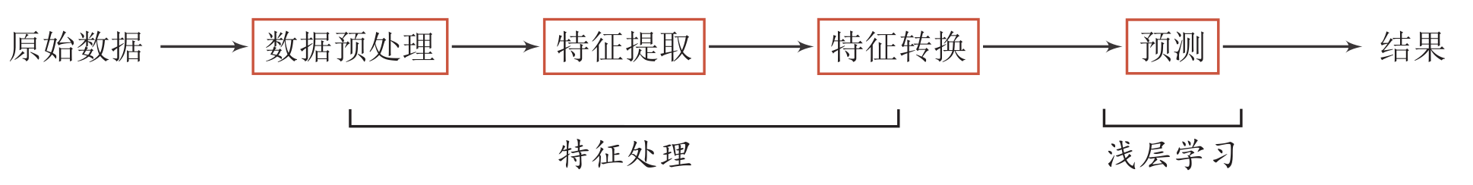
Machine Learning (ML)
When we use ML to solve some pattern recognition tasks, the general process includes the following steps:
Shallow Learning: It does not involve feature learning, and its features are mainly extracted by manual experience or feature conversion method.
特征工程（Feature Engineering）
Notes:
数据预处理：质量差的数据扔掉
特征提出：抽出一部分，去掉不重要的，挖掘隐含特征。
特征转化：组合，去除冗余

Slide 34
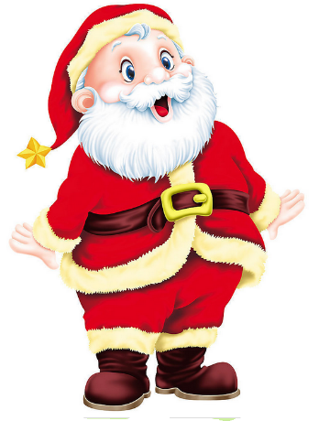
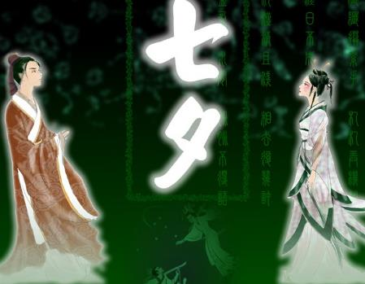
Semantic Gap: One of the Challenges of AI
Low-level characteristics VS High-level Semantics
People's understanding of texts and images cannot be directly obtained from underlying features of character strings or images.
床前明月光，
疑是地上霜。
举头望明月，
低头思故乡。
Notes:
人们对文本、图像的理解无法从字符串或者图像的底层特征直接获得，它需要使用人们日常生活中积累的大量经验和知识来进行推理和判断。
对于一些高层次的抽象概念，如一幅关于节日的图像所表达出的欢乐和喜庆的感觉等，更需要根据人的知识来判断。
圣诞老人底层特征是像素。
七夕，底层特征看不到牛郎织女。
文本，底层特征是字。

Slide 35
What is a good representation？
"Good representation" is a very subjective concept and there is no clear standard.
But a good representation has the following advantages:
Have strong presentation ability
Make the follow-up learning tasks simple
be general and independent of tasks or fields
Data representation is the core problem of ML
Feature engineering: the need for human intelligence
Notes:
现代科学以物理、数学为典范，表达规律的等式实质上都是要在某种变化中，表示出一种能用量的关系显示出来的不变性的规律。
近义词：换汤不换药，殊途同归
把主要常见的动作、情形，归纳成几个公式(或说是套路、围棋定式之类的东西)，

Slide 36
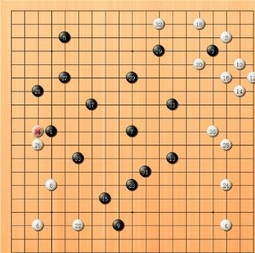
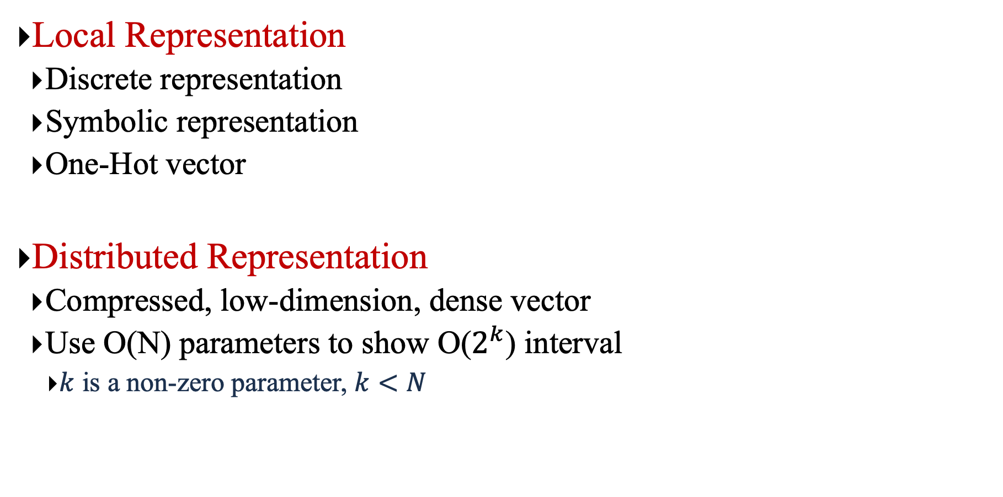
Representation Form
Local Representation
Discrete representation
Symbolic representation
One-Hot vector
Distributed Representation
Compressed, low-dimension, dense vector
Use O(N) parameters to show O($2^{k}$) interval
$k$ is a non-zero parameter, $k<N$
 | Local | Distributed
A | [1 0 0 0] | [0.25 0.5]
B | [0 1 0 0] | [0.2 0.9]
C | [0 0 1 0] | [0.8 0.2]
D | [0 0 0 1] | [0.9 0.1]
Distributed Representation
Notes:
分布式表示：多个维度合起来共同表示一个语义。
局部表示：k维表示k个语义；分布式表示：每个维度表示2个语义，2^k
RBMs, sparse coding, auto-encoders or
multi-layer neural networks can all represent up to O(2k) input
regions using only O(N) parameters (with k the number of
non-zero elements in a sparse representation, and k = N in
non-sparse RBMs and other dense representations).

Slide 37

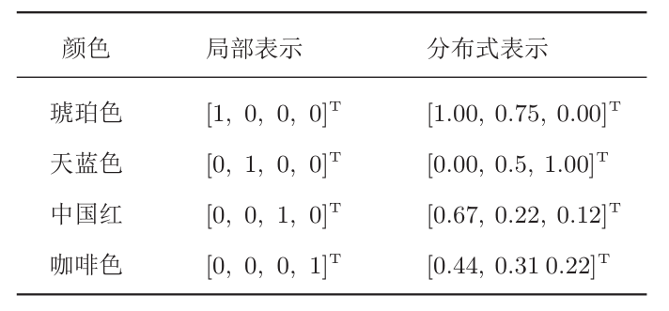
An example in life: Color
Notes:
据不完全统计，现有的颜色命名已经有1300多种
即神经元和颜色名字是“多对多”关系。
很有很多比如``红色''、``白色''、``黑色''、``绿色''，还有以地区或物品命名的，比如“中国红”、“普鲁士蓝”、“咖啡色”、“奶油色”等等。
分布式表示：相似度计算更理想。

Slide 38
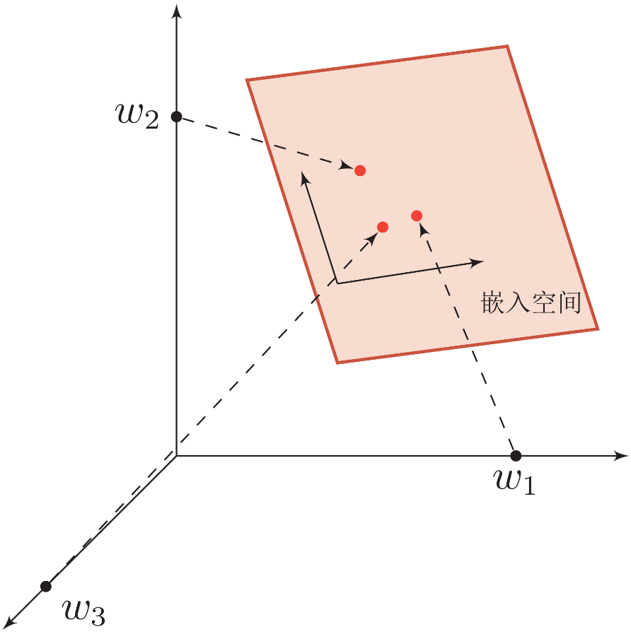
Semantic Representation
How to express semantics in a computer?
Local Representation
Distributed Representation
Knowledge base, rules
Embedding: compressed, low-dimensional, dense vector
Embedding
One-Hot vector

Slide 39
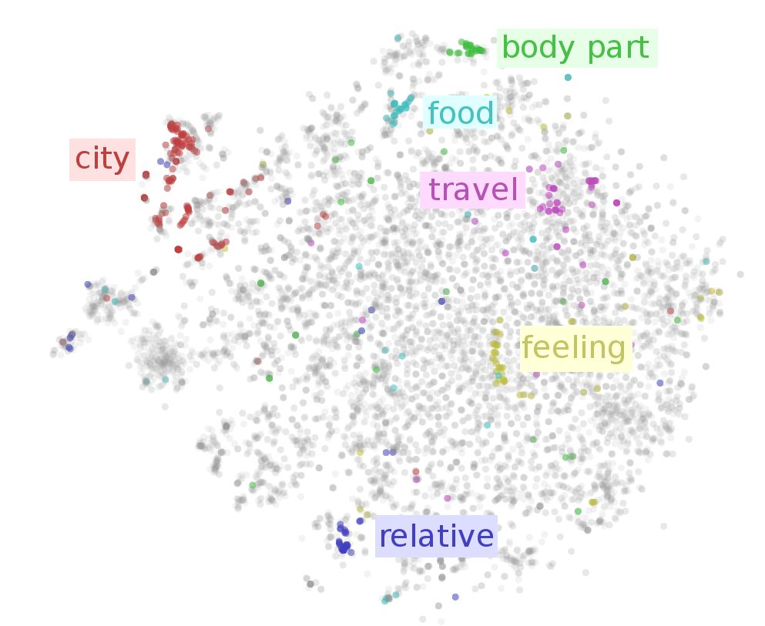
Word Embeddings
上海
北京
高兴
难过
https://indico.io/blog/visualizing-with-t-sne/

Slide 40
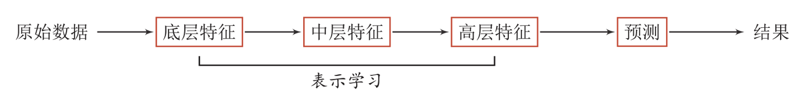
Representation Learning
Representation learning: how to automatically learn good representations from data
By constructing a model which can automatically learn good feature representation (from bottom features to middle features and then to high features), thus ultimately improving the accuracy of prediction or recognition.
Bengio, Yoshua, Aaron Courville, and Pascal Vincent. "Representation learning: A review and new perspectives." IEEE transactions on pattern analysis and machine intelligence 35.8 (2013): 1798-1828.

Slide 41
Traditional Feature Extraction
Feature extraction
Linear projection (Subspace)
PCA、LDA
Nonlinear embedding
LLE、Isomap、Spectral methods
Anto-encoder
Feature Extraction VS Representation Learning
Feature extraction: removing useless features based on tasks or prior pairs.
Representation learning: learning high-level semantic features through depth model.
Difficulties: there is no clear goal!
Notes:
表示学习：希望学到的表示对后面的分类是有帮助的。

Slide 42
1.4 Machine Learning

Slide 43
Machine Learning ≈ Construct a mapping function (rule)
Speech recognition
Image recognition
围棋
Machine Translation
“你好”
“9”
“6-5”
(落子位置)
“你好！”
“Hello!”

Slide 44
Why do we need ML?
The problems in the real world are more complicated. Difficult to achieve it manually through rules.
Map function, how?
Learn rules from a large number of data

Slide 45
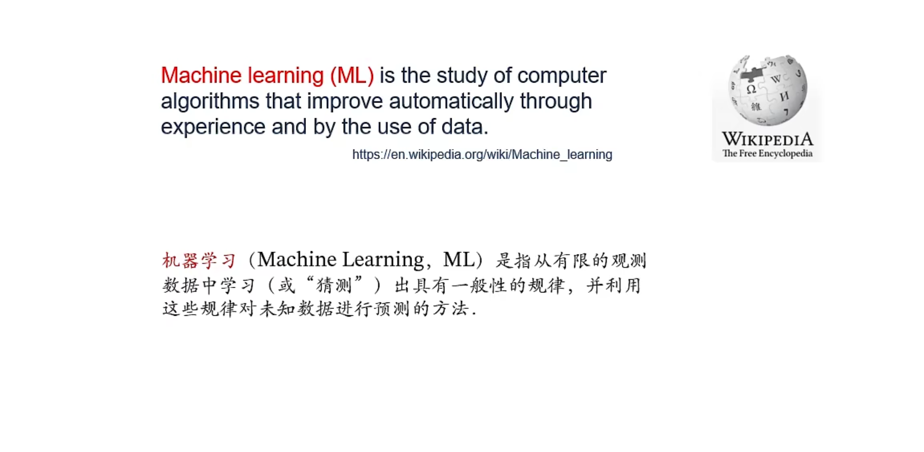
Definition of ML

Slide 46
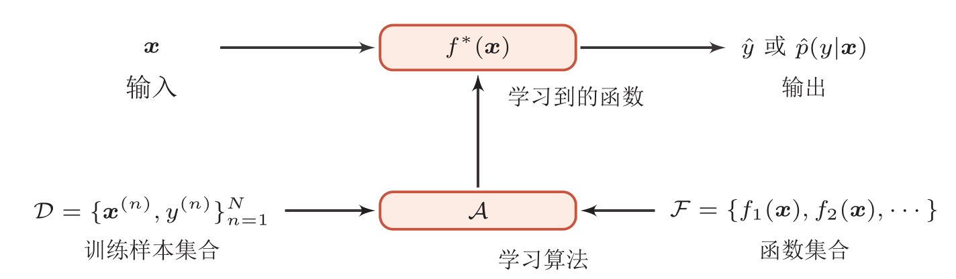
Definition of ML
ML: through algorithms, machines can learn rules from a large number of data and make decisions on new sample
Rules: decision (prediction) function
Input
Output
Different ML model
Independent and Identical distribution p(x,y)

Slide 47
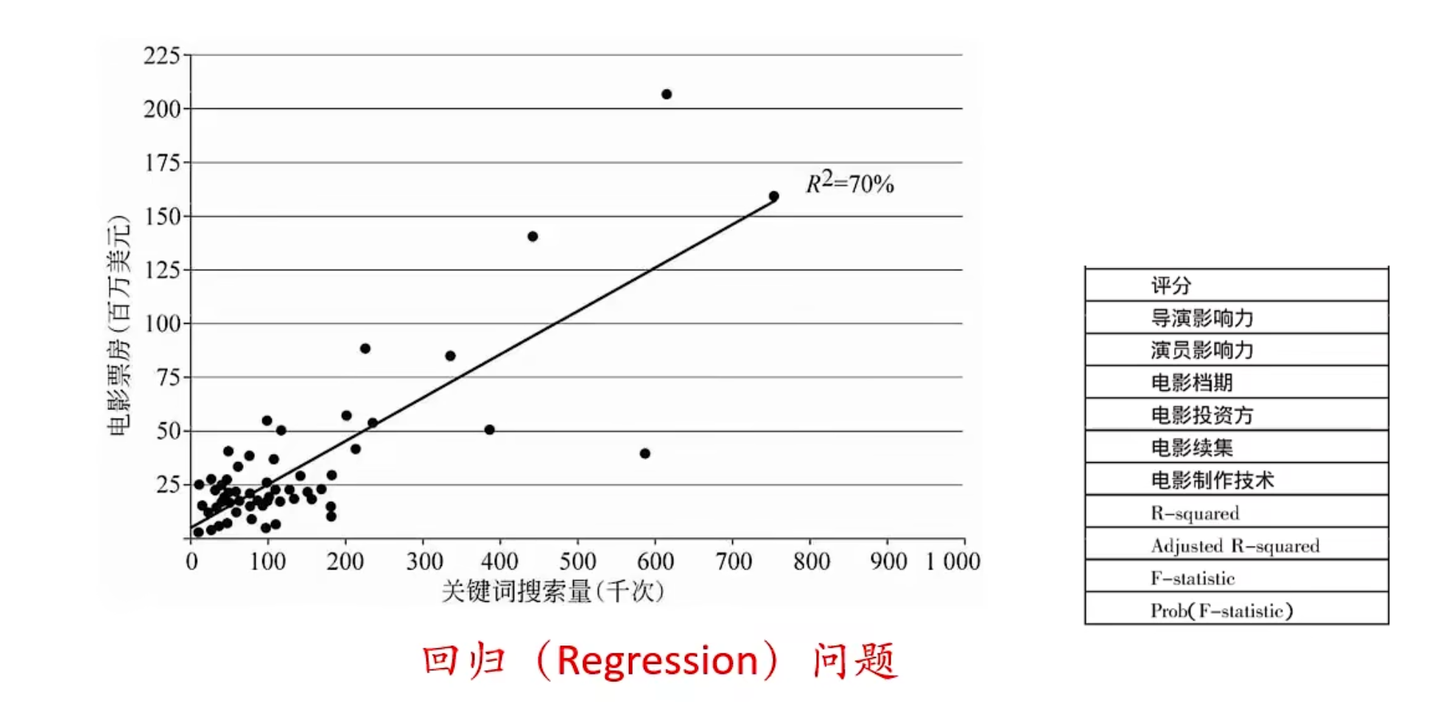
Example: Movie sale prediction

Slide 48
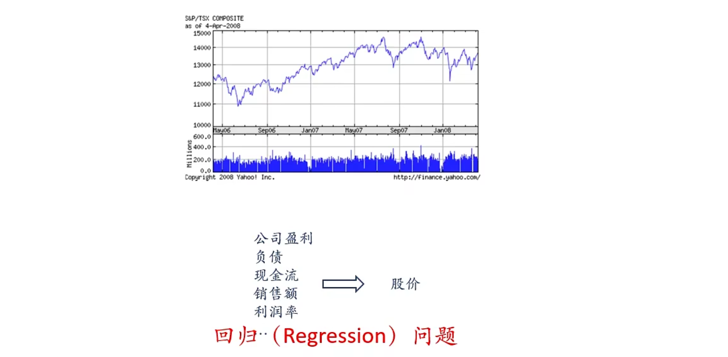
Example: Stock Price Prediction

Slide 49
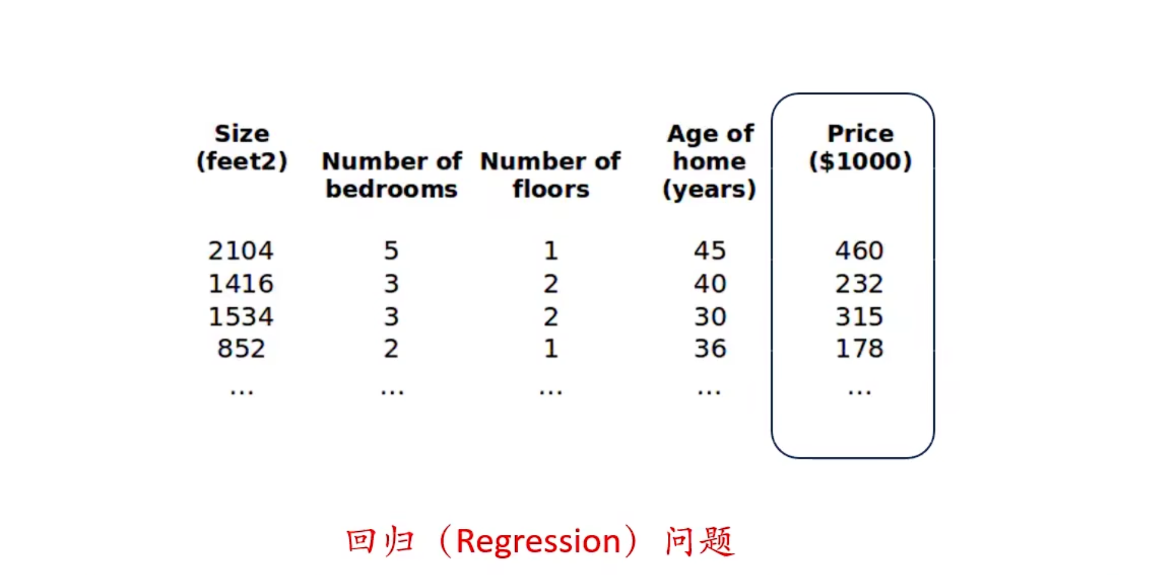
Example: House Price Prediction

Slide 50
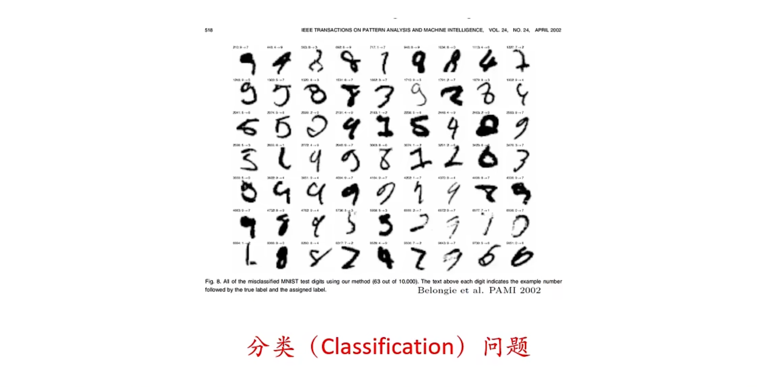
Example: Handwritten Digit Recognition

Slide 51
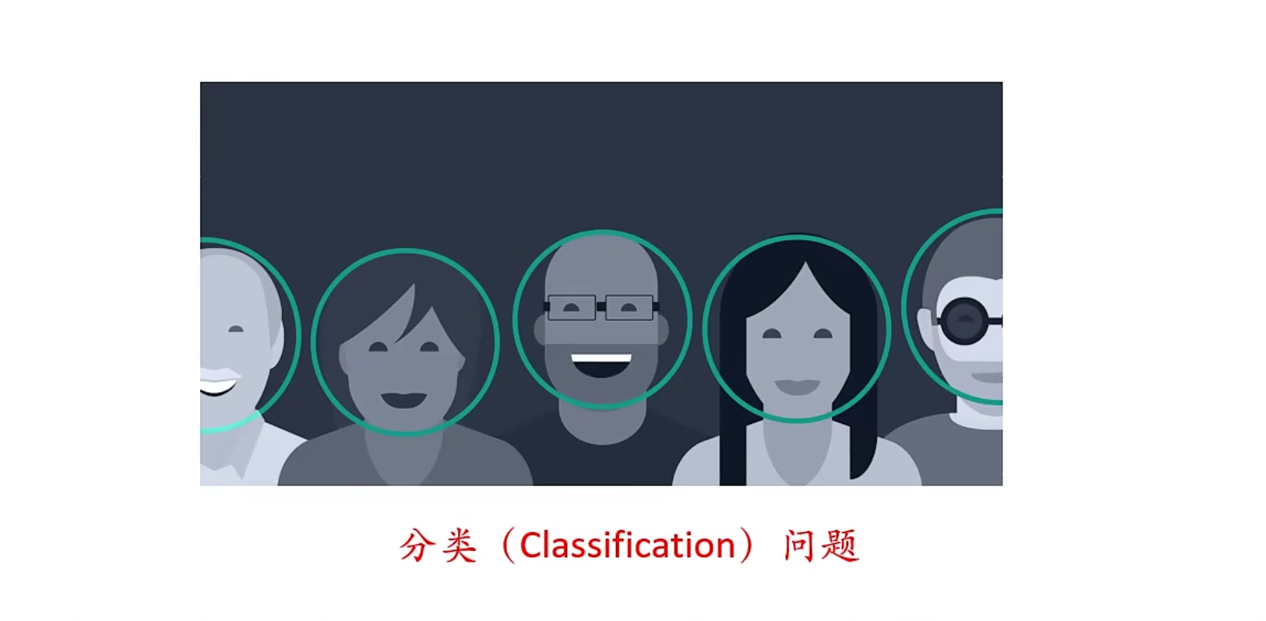
Example: Face Detection

Slide 52
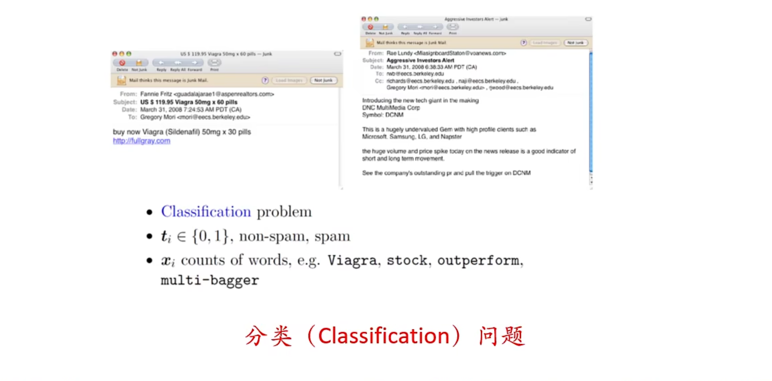
Example: Spam Detection

Slide 53
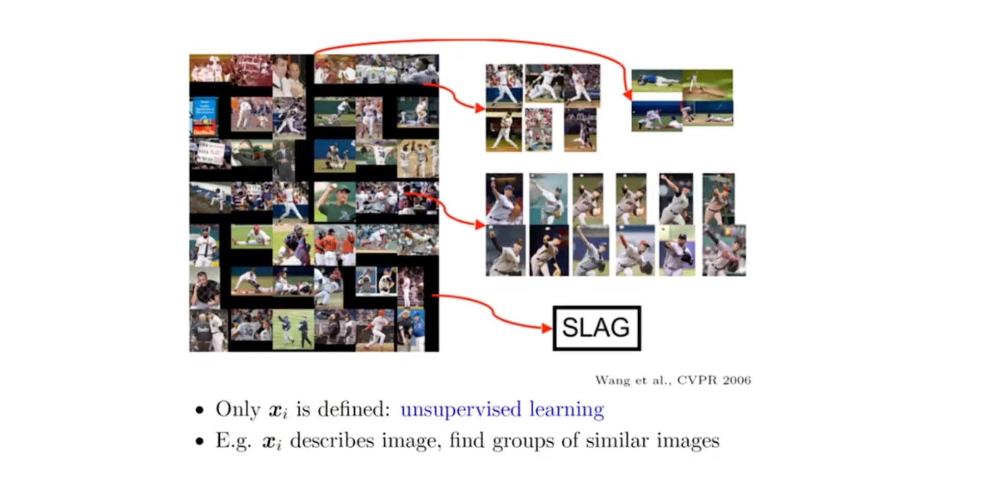
Example: Image Clustering

Slide 54
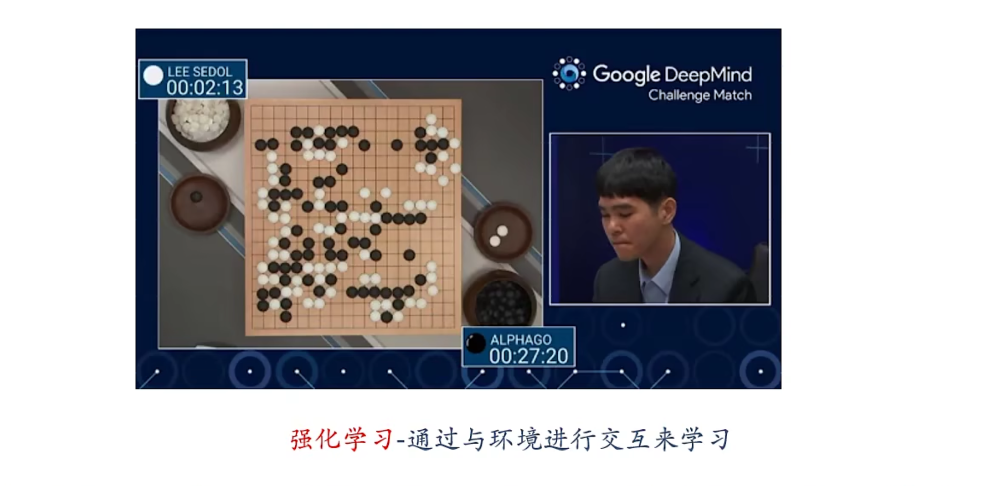
Example: AlphaGo

Slide 55
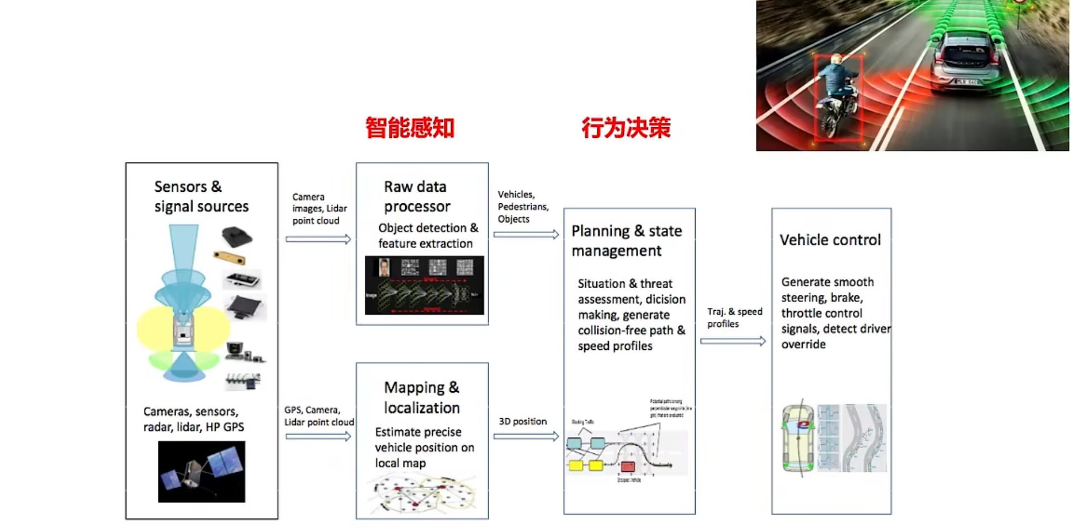
Example: Anto-Driving

Slide 56
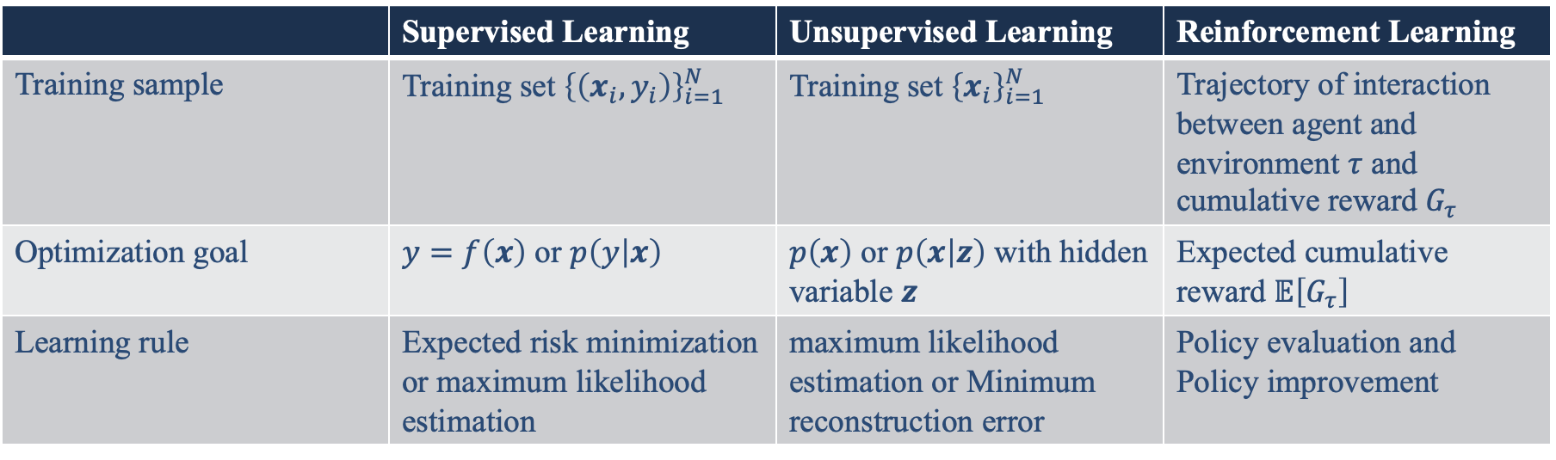
ML Problem Summarization
 | Supervised Learning | Unsupervised Learning | Reinforcement Learning
Training sample | Training set ${\left\{\left(x_{i},y_{i}\right)\right\}}_{i=1}^{N}$ | Training set ${\left\{x_{i}\right\}}_{i=1}^{N}$ | Trajectory of interaction between agent and environment $τ$ and cumulative reward $G_{τ}$
Optimization goal | $y=f\left(x\right)$ or $p\left(y | x\right)$ | $p\left(x\right)$ or $p\left(x | z\right)$ with hidden variable $z$ | Expected cumulative reward $𝔼\left[G_{τ}\right]$
Learning rule | Expected risk minimization or maximum likelihood estimation | maximum likelihood estimation or Minimum reconstruction error | Policy evaluation and Policy improvement

Slide 57
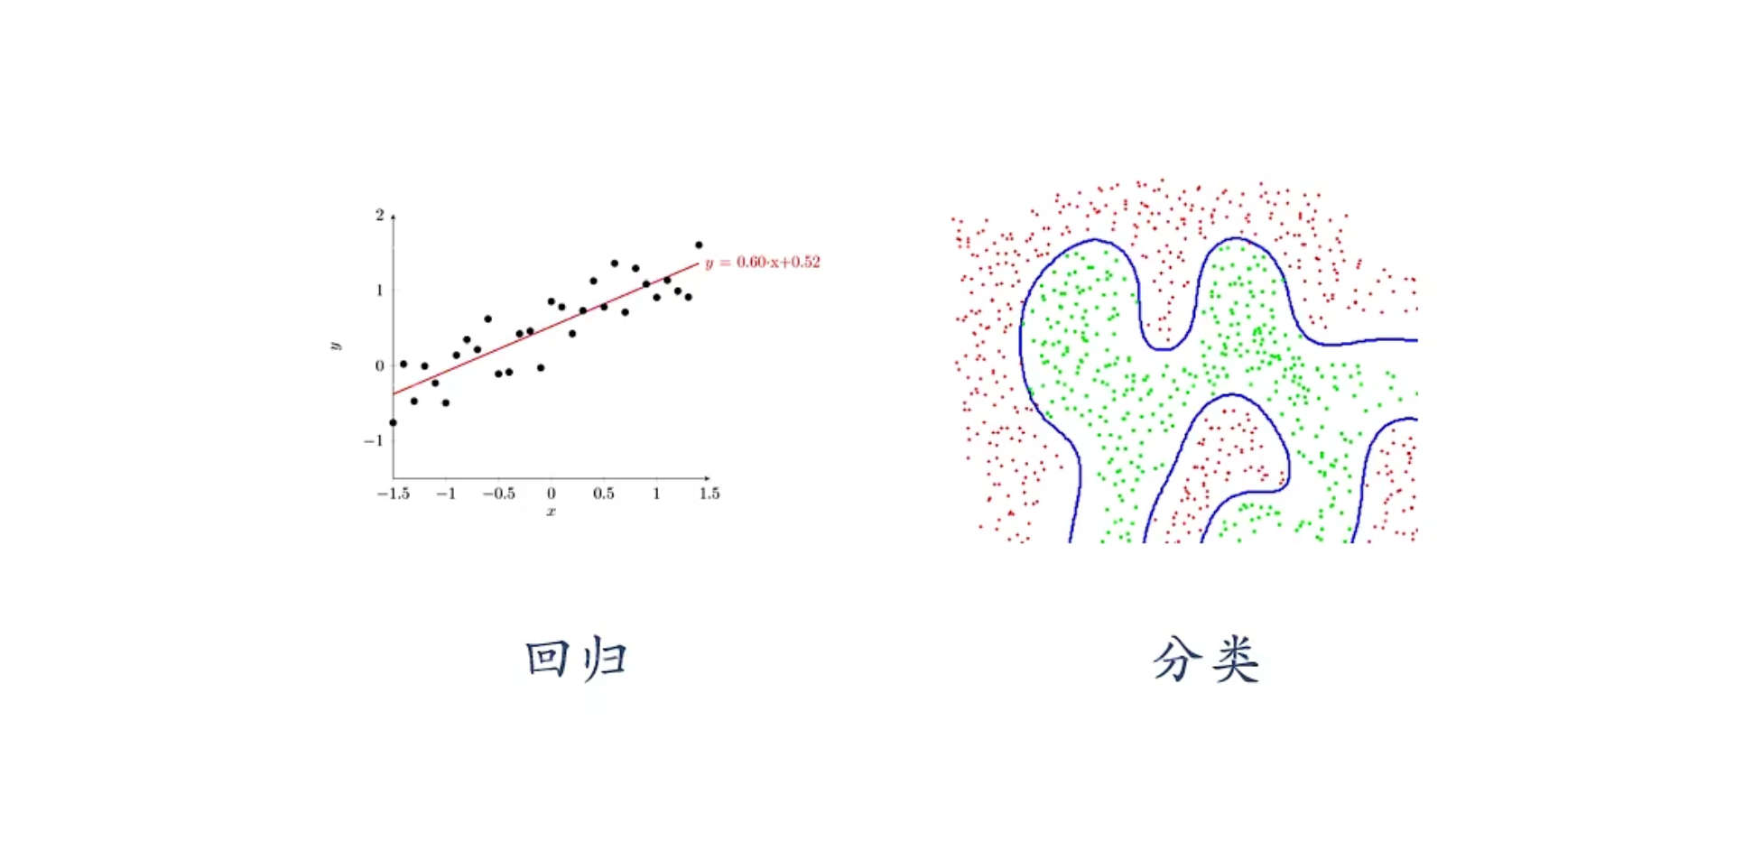
Typical Supervised Learning
Regression
Classification

Slide 58
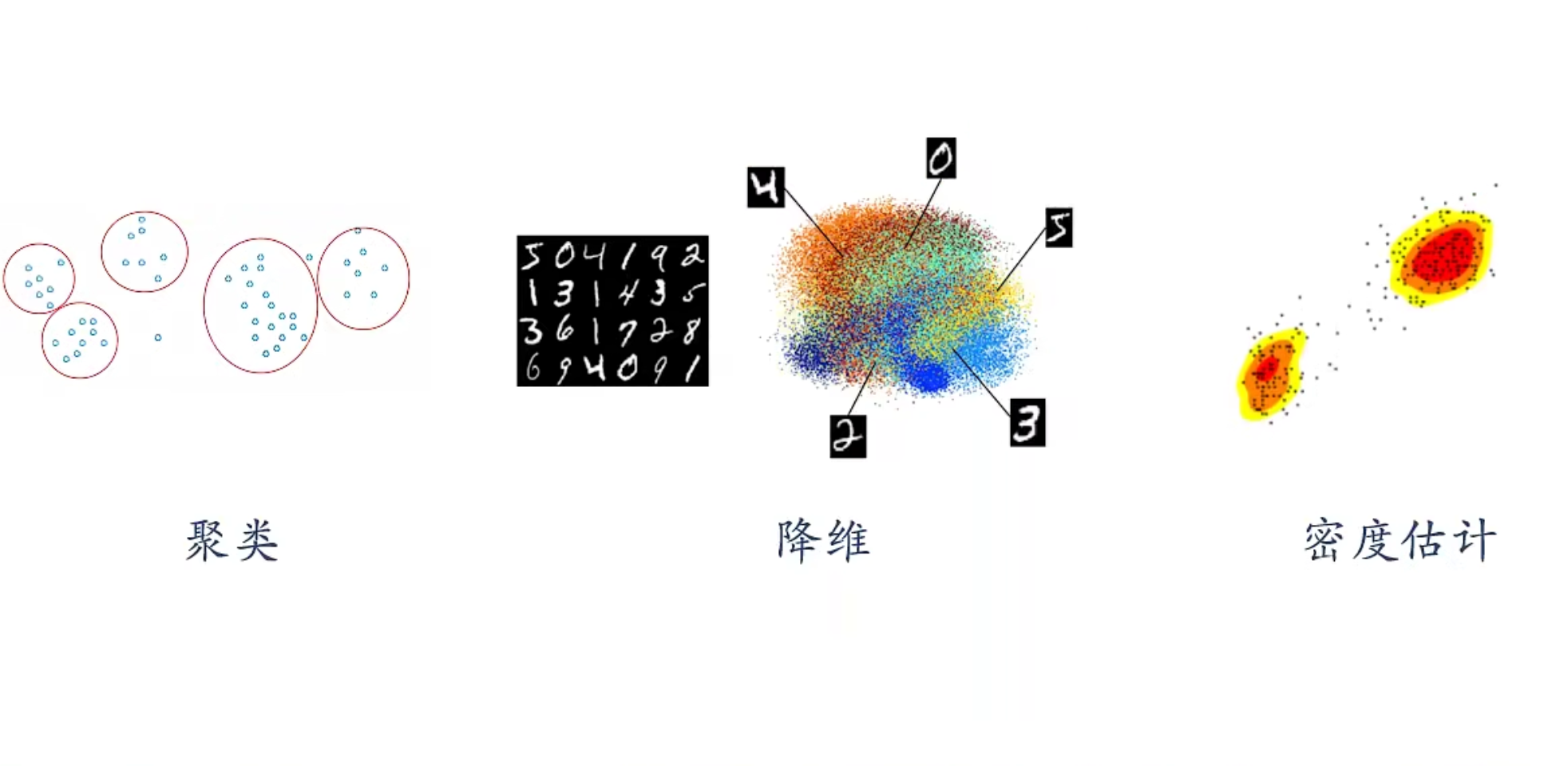
Typical Unsupervised Learning
Clustering
Dimension Reduction
Density Estimation

Slide 59
1.5 Deep Learning

Slide 60
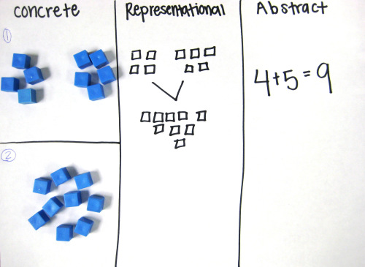
Representation Learning v.s. Deep Learning
A good presentation learning strategy must have a certain depth
Feature reuse
Exponential representation ability
Abstract representation and invariance
Abstract representation requires multi-step construction
https://mathteachingstrategies.wordpress.com/2008/11/24/concrete-and-abstract-representations-using-mathematical-tools/
Notes:
Deep architectures can lead to abstract representations because more abstract concepts can often be constructed in terms of less abstract ones.
深度：输入到输出之间的路径（信用分配）
多层人工神经网络
层数大于1
Schmidhuber: 10 is sure deep

Slide 61
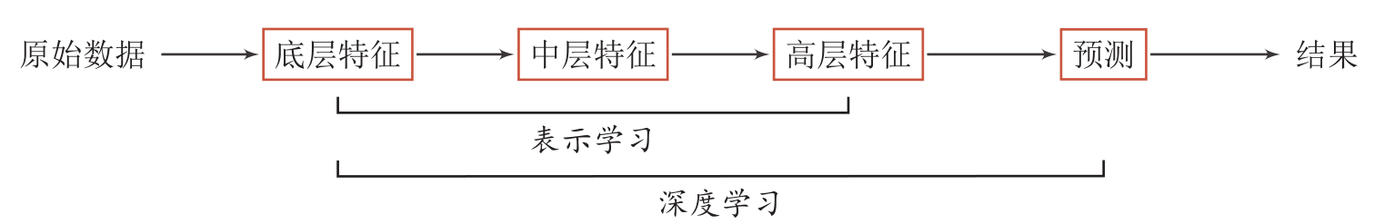
Deep Learning
Deep Learning = Representation Learning + Decision/Prediction Learning
Contribution distribution problem
贡献度分配问题
Notes:
贡献度分配问题：从x到y经过了很多模块，每个模块对结果的好坏影响多少。
例子，下棋。

Slide 62

Representation Learning v.s. Deep Learning (End-to-End)

Slide 63
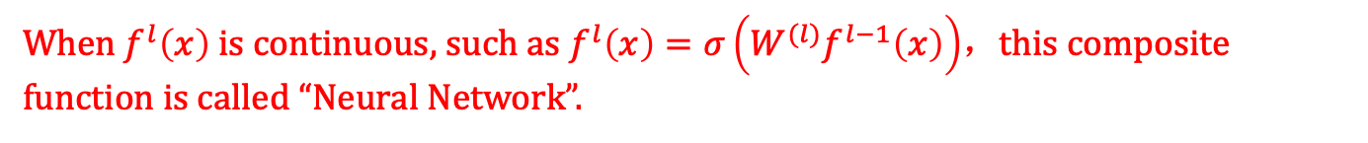
Mathematical Description of Deep Learning
$$y=f\left(x\right)$$
𝑦=𝑓(𝑥)
$$y=f2(f1\left(x\right))$$
𝑦=𝑓²(𝑓¹(𝑥))
$$y=f5(f4(f3(f2(f1\left(x\right)))))$$
𝑦=𝑓⁵(𝑓⁴(𝑓³(𝑓²(𝑓¹(𝑥)))))
…
Shallow Learning
Deep Learning
$fl\left(x\right)$ is non-linear function, and not necessarily continuous
When $f^{l}\left(x\right)$ is continuous, such as $f^{l}\left(x\right)=σ\left(W^{(l)}f^{l−1}\left(x\right)\right)$，this composite function is called “Neural Network”.
Notes:
复合函数

Slide 64
1.6 Neural Networks

Slide 65

Biological Neuron
video: structure of brain
The human brain has 86 billion neurons.
A single nerve cell has only two states: Excitation (兴奋)
Inhibition (抑制)
Notes:
细胞体（Soma）中的神经细胞膜上有各种受体和离子通道，胞膜的受体可与相应的化学物质神经递质结合，引起离子通透性及膜内外电位差发生改变，产生相应的生理活动：兴奋或抑制。
细胞突起是由细胞体延伸出来的细长部分，又可分为树突和轴突。
树突（Dendrite）可以接受刺激并将兴奋传入细胞体。每个神经元可以有一或多个树突。
轴突(Axons)可以把兴奋从胞体传送到另一个神经元或其他组织。每个神经元只有一个轴突。

Slide 66
How to learn neural networks?
Hebb's Rule (赫布法则)
When an axon of neuron A is close enough to neuron B to influence it and continuously and repeatedly participate in the excitement of neuron B, then some growth process or metabolic changes will occur in one or both of these neurons, so that neuron A, as one of the cells that can excite neuron B, has enhanced its efficiency.
----Canadian psychologist Donald Hebb
《Organization of behavior》1949
Memories in the human brain: long-term memory and short-term memory. Short-term memory lasts no more than one minute. If an experience is repeated enough times, it can be stored in long-term memory.
The process of transforming short-term memory into long-term memory is called coagulation.
Hippocampus in human brain is the core area of brain structure coagulation.
Notes:
当神经元 A的一个轴突和神经元B很近，足以对它产生影响，并且持续地、重复地参与了对神经元B的兴奋，那么在这两个神经元或其中之一会发生某种生长过程或新陈代谢变化，以致于神经元A作为能使神经元B兴奋的细胞之一，它的效能加强了。

Slide 67
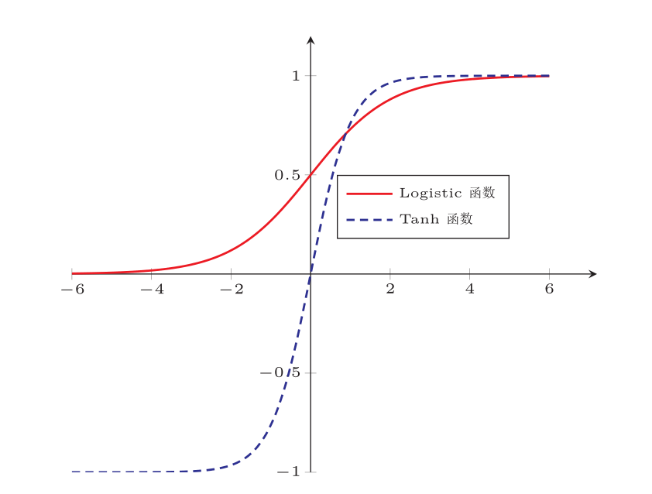
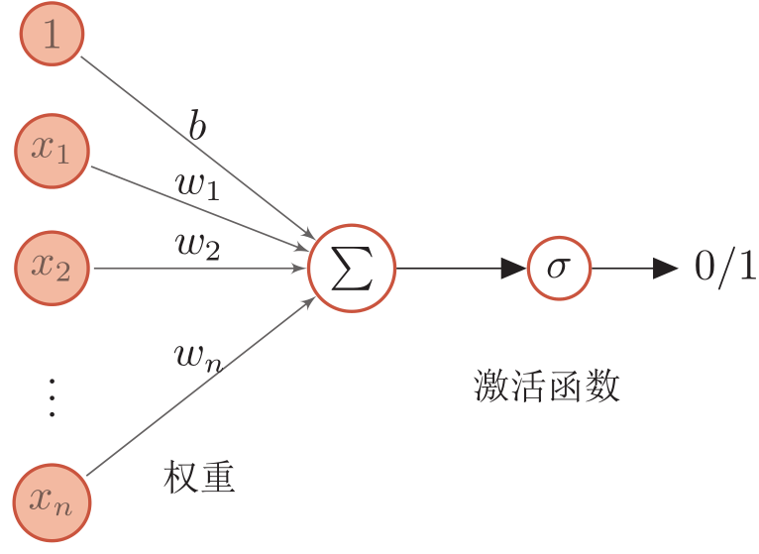
Artificial Neuron
Activation Function

Slide 68
Artificial Neural Networks (ANNs)
ANN is mainly composed of many neurons and their directed connections. So consider three aspects:
Activation rules of neurons
mapping relationships between the input and output of neurons, which is generally a nonlinear function.
Topological structures of networks
The connection between different neurons.
Learning algorithms
The parameters of neural network are learned by training data.

Slide 69
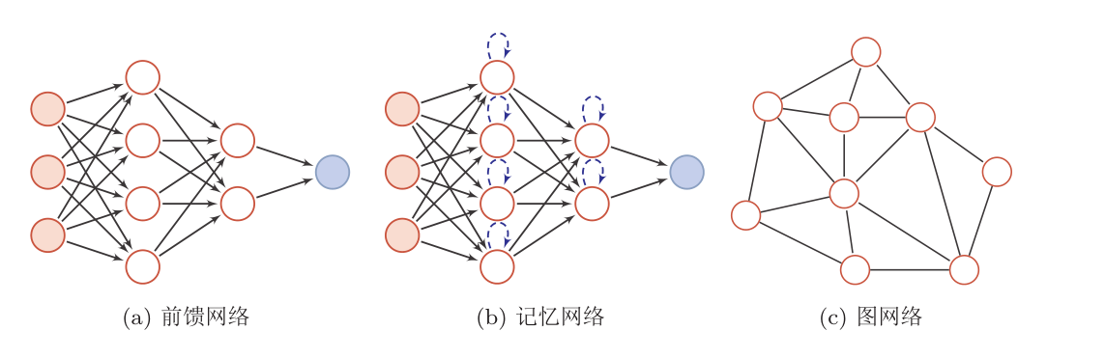
Artificial Neural Networks (ANNs)
ANN is composed of neuron: information processing network composed of many neurons has a parallel distribution structure.
Here, the neural network is divided into three types:
Forward Network (FN)
Memory Network
Graph Network
Notes:
虽然这里将 神经网络结构大体上分为三种类型，但是大多数网络都是复合型结构，即一个神经网络中包括多种网络结构。

Slide 70
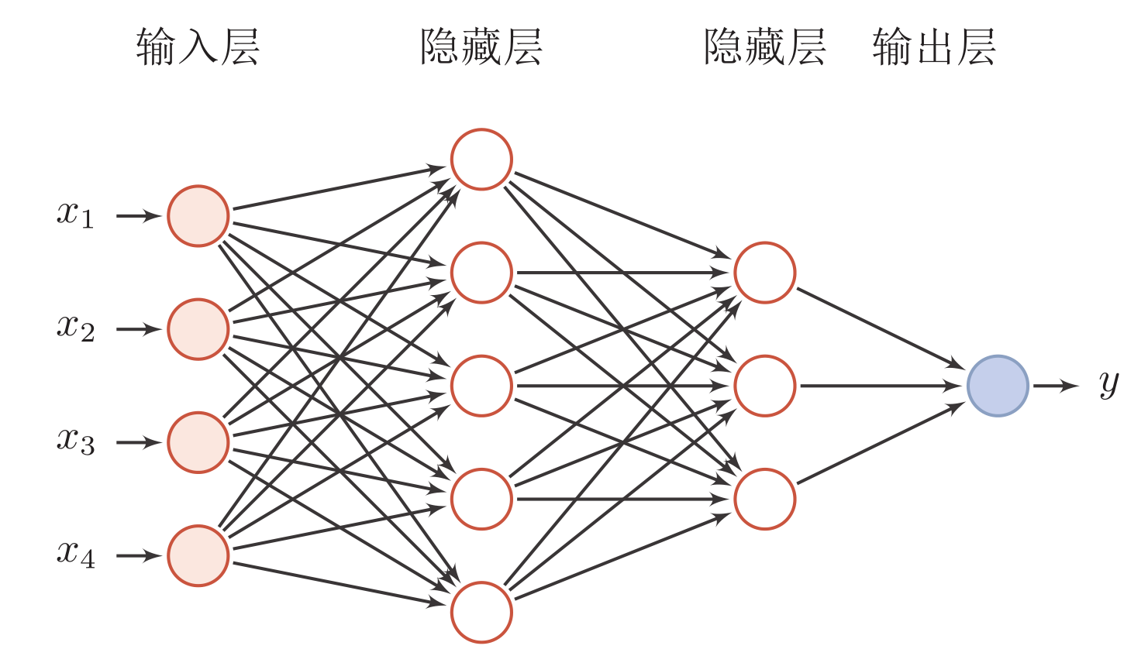
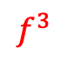
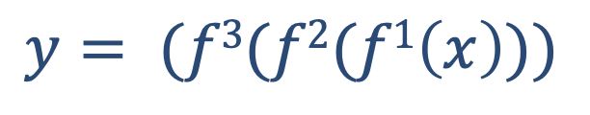
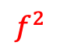
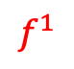
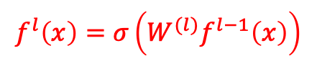
神经网络
Input layer
Hidden layer
Output layer
$$f^{3}$$
$$y= (f3(f2(f1\left(x\right)))$$
$$f^{2}$$
$$f^{l}\left(x\right)=σ\left(W^{(l)}f^{l−1}\left(x\right)\right)$$
$$f^{1}$$

Slide 71
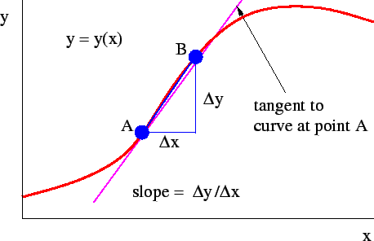

Contribution Distribution: Solved?
Partial Derivative
Contribution
$$\frac{∂y}{∂W^{(l)}}=\frac{y\left(W^{(l)}+∆W\right)−y(W^{(l)})}{∆W}$$
Neural network is not deep learning naturally, but deep learning is neural network naturally.

Slide 72
1.7 Development History of ML

Slide 73
History of Neural Networks (NNs)
Development of NN has roughly gone through five stages
First stage: model presentation
In 1943, psychologist Warren McCulloch and mathematician Walter Pitts first described an idealized ANN, constructed a calculation mechanism based on simple logical operations (MP model)
In 1948, Turing described a “B-type Turing Machine” (Hebb Learning)
In 1951, McCulloch and Pitts’ student Marvin Minsky built the first NN machine called SNARC.
In 1958, Rosenblatt first proposed a NN model that can simulate human perception, and called it “Perceptron”, and proposed a learning algorithm that is close to human learning process (iteration, trial and error).

Slide 74
History of Neural Networks (NNs)
Second stage: ice age (冰河期)
In 1969, Marvin Minsky published "Perceptron”: NN were put into limbo directly, which led to the "ice age" of NN for more than ten years. They found two key problems of neural network:
The basic perceptron cannot handle XOR loops.
Computers are not capable enough to handle the long calculation time required by large-scale NNs.
In 1974, Paul Webos (Harvard Uni.) invented the back propagation (BP) algorithm, but it was not paid due attention at that time.
In 1980, Kunihiko Fukushima (福岛邦彦) proposed a multi-layer neural network with convolution and sub-sampling operations: Neocognitron (新智机).

Slide 75
History of Neural Networks (NNs)
Third stage: revival caused by BP algorithm
In 1983, physicist John Hopfield introduced the concept of energy function to NN, and proposed a network for associative memory and optimization calculation (Hopfield network), which obtained the best results at that time on the traveling salesman problem (TSP) and caused a sensation.
In 1984, Geoffrey Hinton proposed a randomized version of Hopfield network, namely Boltzmann machine.
In 1986, David Rumelhart and James McClelland provided a comprehensive discussion on the application of connectionism in computer simulation of neural activities, and re-invented the BP algorithm.

Slide 76
History of Neural Networks (NNs)
Third stage: revival caused by BP algorithm
In 1986, Geoffrey Hinton and others will introduce the BP algorithm to the multilayer perceptron.
In 1989, LeCun and others introduced the BP algorithm into convolutional neural networks (CNNs), and achieved great success in handwritten numeral recognition.

Slide 77
History of Neural Networks (NNs)
Fourth stage: the popularity is reduced
In the mid-1990s, statistical learning theory and machine learning model, such as support vector machine (SVM) began to rise.
In contrast, the shortcomings of NNs, such as unclear theoretical basis, difficult optimization and poor interpretability, are more prominent, and the research of NNs has once again fallen into a low tide.
This part, including statistical learning and ML (not including NN) are called “traditional ML”
This is the core content of this course

Slide 78
History of Neural Networks (NNs)
Fifth stage: the rise of deep learning
In 2006, Hinton and others found that multi-layer feedforward NNs (MLP) can be effectively learned by pre-training layer by layer and then fine-tuning with BP algorithm.
Great success of deep NN in speech recognition and image classification.
In 2013, AlexNet: The first modern deep CNN was the beginning of a real breakthrough in image classification by deep learning.
AlexNet uses many modern deep network technologies for the first time without pre-training and layer-by-layer training.
With the large-scale parallel computing and popularity of GPU devices, the computing power of computers has been greatly improved. In addition, the scale of data available for ML is also growing. With the support of computing power and data scale, computers have been able to train large-scale ANNs.

Slide 79
Revolution of deep learning
Artificial Intelligence (AI)
Speech recognition: It can reduce the word error rate from 1/4 to 1/8.
Computer vision: target recognition, image classification, etc.
Natural language processing: distributed representation, machine translation, question answering, etc.
Information retrieval and social network
Three Deep：
Deep Blue
Deep QA
Deep Learning
Notes:
Deep Blue was a chess-playing expert system run on a unique purpose-built IBM supercomputer.
发展历史
1958 年 Rosenblatt 感知器
1969 年 Minsky XOR
1986 年 Hinton、LeCun 人工神经网络（BP 算法）
1998 年 LeCun 卷积神经网络
2006 年 Hinton 深度网络

Slide 80

Three carriages of Deep Learning
Toronto University
Hinton: PhD of Edinburgh University in 1975
NYU
Lecun (Now Facebook): Hinton’s Postdoc in 1987
Montreal University
Bengio: M. Jordan’s Postdoc in 1991
IDSIA
Jürgen Schmidhuber
2018 Turing award winner
Notes:
LeCun /ləˈkʌn/

Slide 81


Slide 82


